Slide 1

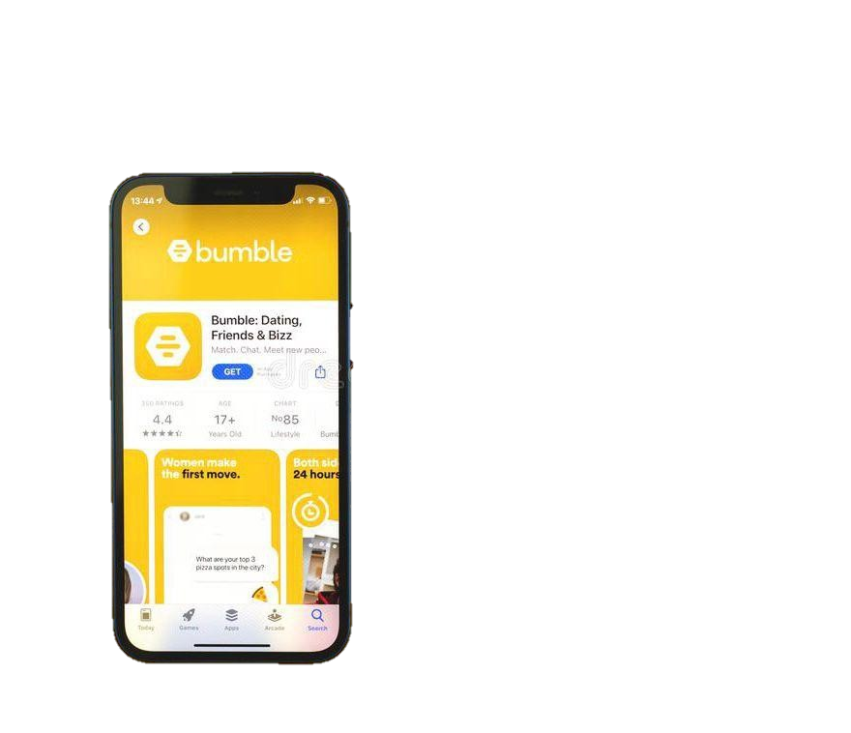

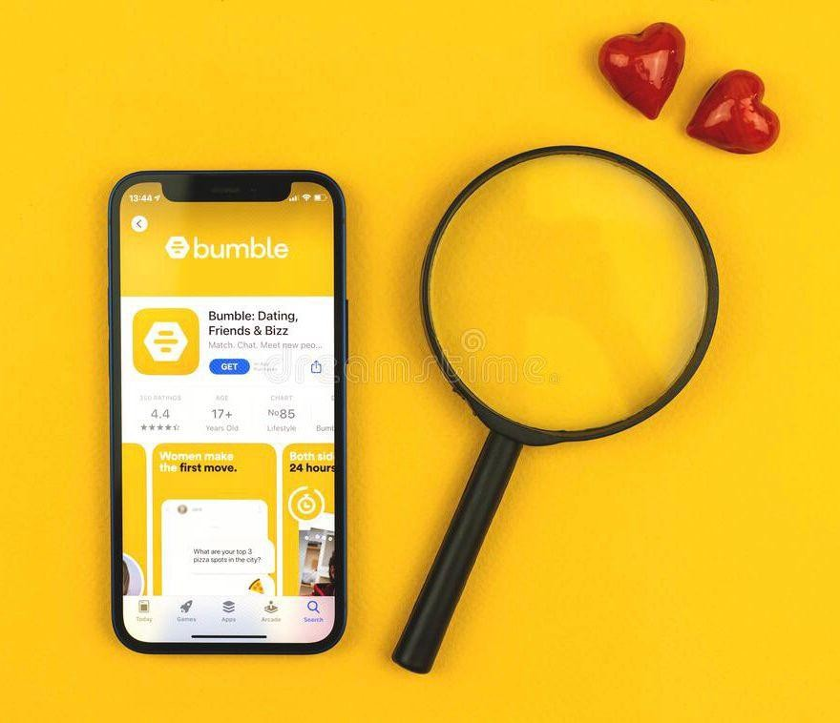














bumble SMASH
x
Name : Banoth Manasa chandra
IIT GUWAHATI

Slide 2



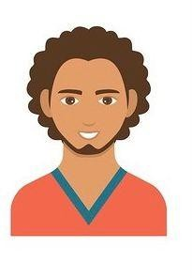

Introduction Analysis Solution
Landing Page Metrics
Problem breakdown
Pitfalls
About the product
Bumble is an online dating application. Profiles of potential matches are displayed to the users, who can swipe left to reject a candidate or swipe right to indicate interest.
What is the problem?
Waiting for a match on bumble can be a tedious process and is often met with disappointment when you don't receive one for a long period of time, especially for males.
Swipes right on profiles who he wants to match with
Does not get matches
Loses confidence in app gradually
Shifts to other dating apps
Wants to meet new people
Is tired of not getting matches
Often loses confidence in himself
Wishes for more matches
Wants to meet like-minded people
Complains about the quality of matches
Wants to see more variety
Often confused about whether to swipe left or right
Rohan, 22 Bangalore
Riya , 19 Mumbai

Slide 3
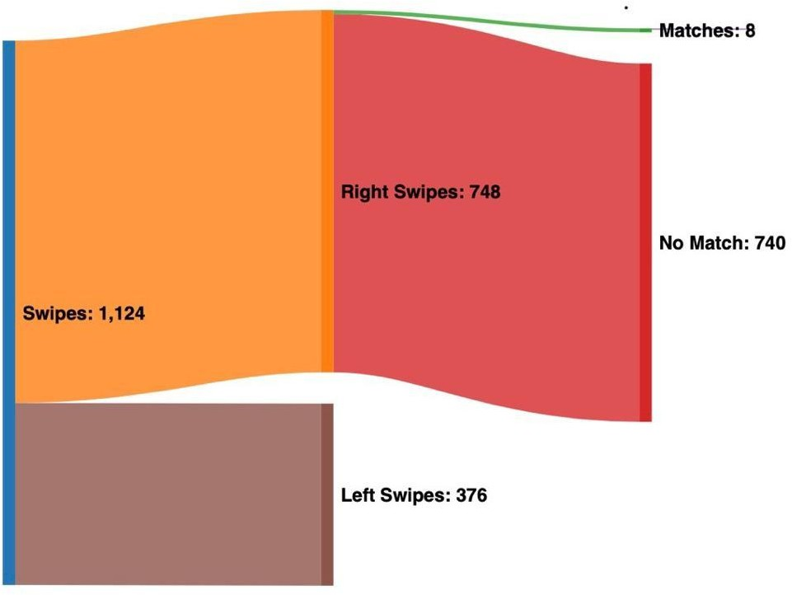
Introduction Analysis
Defining the problem
User Research
Solution
Landing Page Metrics Pitfalls
Sankey Diagram for bumble user behaviour
What to solve first? _{(1-Low, 5-High)}
(Link)
76% of users complained about having fewer matches on Bumble.
-87% of male users complained about having fewer matches
64% of female users found their matches to be not interesting.
91% of users felt that it would have helped if they had a reference to choose from
-22% of users did not receive a message after matching
For a total of 1124 swipes there were only 8 matches
Link for data
Why solve this now?
Business Value
Online dating platforms have a cut-throat competition for a similar user base.
Solving the problem of getting matches can get us way ahead in the game in terms of user acquisition and user satisfaction.
-Due to the pandemic, Gen Z prefer to meet online rather than oﬄine
Bumble Smash can be a game-changer in the user segment with potential to attract competitor customers.
It can increase the number of users who will avail the Bumble premium service and thus provide monetary benefit.

Slide 4

Introduction Analysis
Possible Solutions
Solution
Metrics
Landing Page
Pitfalls
Bumble Smash
Users will be shown two profiles simultaneously and will be asked to swipe right on any one of them.
Users will have an AI assistant to help them curate a perfect profile. It will help them select their best pictures and suggest a bio according to their personalities.
Bumble Buzz
Users will be able to text the profiles they swipe right on before matching for bumble tokens.
Bumble Bot
Parameter | Bumble Smash | Bumble Bot | Bumble Buzz
Customer need
Effciency
Revenue potential
Ease of use
Implementation eﬀort

Slide 5
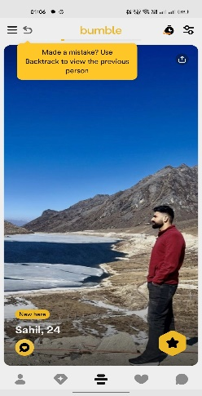




Introduction Analysis Solution
Landing Page
Metrics
Pitfalls
The solution : Bumble Smash
How Does it Work?
Bumble Smash is the new way people will swipe on the profiles they want to match with.
User will be shown two profiles simultaneously and will swipe right on the profile they want to vibe with.
User will have the option to swipe right on any one of the two profiles displayed or they can swipe left to see 2 new profiles
Right swipe
Creates a reference based swiping mechanism
Saves user from excessive cognitive overload
Sunny,21
Psychological Aspect
Often the brain fails to make the right decision when given too many options and no reference.
For a dating site, every failed choice results in a loss of a potential match.
When choosing between 2 similar objects, the brain invariably decides on a winner
This is what Bumble Smash relies on.
Right swipe
Sunny,21
Left swipe

Slide 6
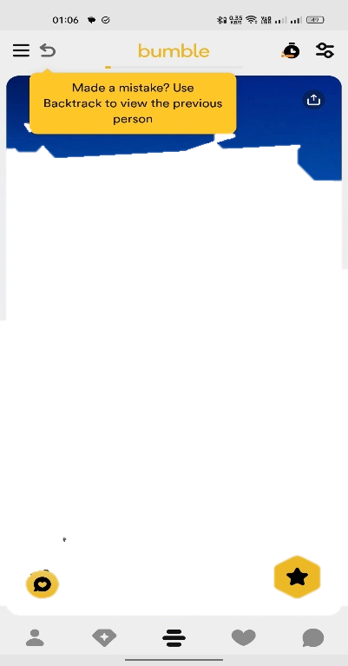


Introduction
Analysis
Solution
Landing Page
Metrics
Pitfalls
Logic
Benefits
Profiles are given a score by bumble based on swipes.
Referenced Based Swiping makes it easier for girls to make a choice.
Profiles with similar scores are displayed together.
This increases the probability of guys to get swiped right.
Scores are updated using the ELO rating system between the two profiles.
In x number of screens,users can now see 2x number of profiles,therefore saving time.
Sunny,21
Previously when swiped left,the profile would vanish forever.
80/20 rule has chained the dating app flow where the top 20% guys have 80% of the matches.
In bumble smash, the profile may appear again according to its updated score.
Sunny,21
Bumble Smash tries to shift the ﬂow to the entire cohort by limiting on the matches obtained by the top 20% and hence providing access to the entire array creating diversity.

Slide 7


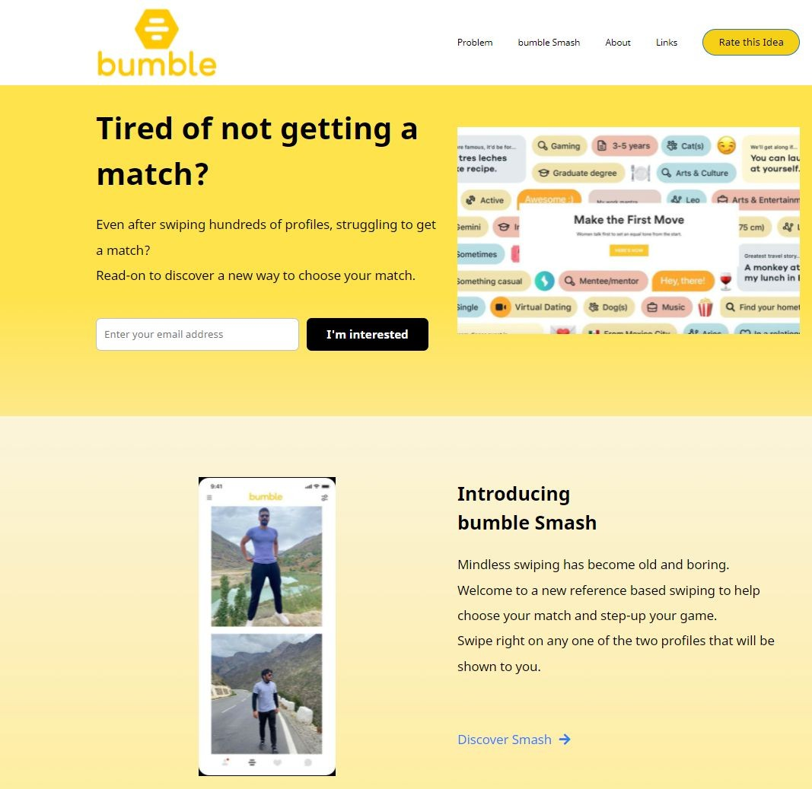




Introduction Analysis Solution
Desirability from users : Landing Page
Landing Page
Metrics
Pitfalls
Page Views 151
New Users 103
Avg Session Duration 32 secs
Bounce Rate 72.96%
Metric | Value
Email Button CTA Click Through Rate (#Email Submissions received / Total # Visitors) | 21%
Feedback Completion Rate (#Feedback submissions / Total # Visitors) | 18%
Customer Satisfaction (User feedback) | 95%
http://bubblemanasa.ccbp.tech
Please refer to above link for full landing page view

Slide 8
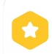
Introduction Analysis
Success Metrics
Solution
Landing Page
Metrics
Pitfalls
Match Rate | Number of Matches / Number of Right Swipes
Conversation Rate | Number of Matches with more than 3 messages exchanged / Number of Total Matches
Date Conversion | % of real or virtual dates / Total number of matches
Bumble premium | % of people subscribing to bumble premium to see the users who have liked their profile after the surge in likes from bumble Smash/ Total number of users
Retention (D7 & D30) | Number of users who use bumble Smash for 1 week (or 1 month) / Number of users who use bumble smash on Day 0
Time spent to get a match | Total time spent swiping on app/ total number of matches
Metrics
Definition

Slide 9

Introduction Analysis
Pitfalls and Solutions
Solution
Landing Page
Metrics
Pitfalls
The feature might be confusing for existing users who have been using bumble for quite some time. | This can be solved by implementing a tutorial which gives the user a walkthrough of the feature.
It may become more diffcult for a few users since they are psychologically used to swiping based on 1 profile. | This will get solved as the users use the feature more often and get accustomed.
Two profiles which are poles apart in the perspective of the user, will make the feature redundant. | The algorithm must be fine tuned in a manner that the two profiles that are shown together are close enough for the user.
There will always be one loser who will not be able to get a match due to being pitted with someone else. | User perceptions can change over time and they might get picked over someone else, some-time later.
Pitfall
Solutions

